Slide 1

Predicting Heart Attack
An Experiment with Supervised Machine Learning base models and healthcare Data

Slide 2
About the project
The importance of predicting health outcomes.
Available Data
Supervised Machine Learning Models

Slide 3
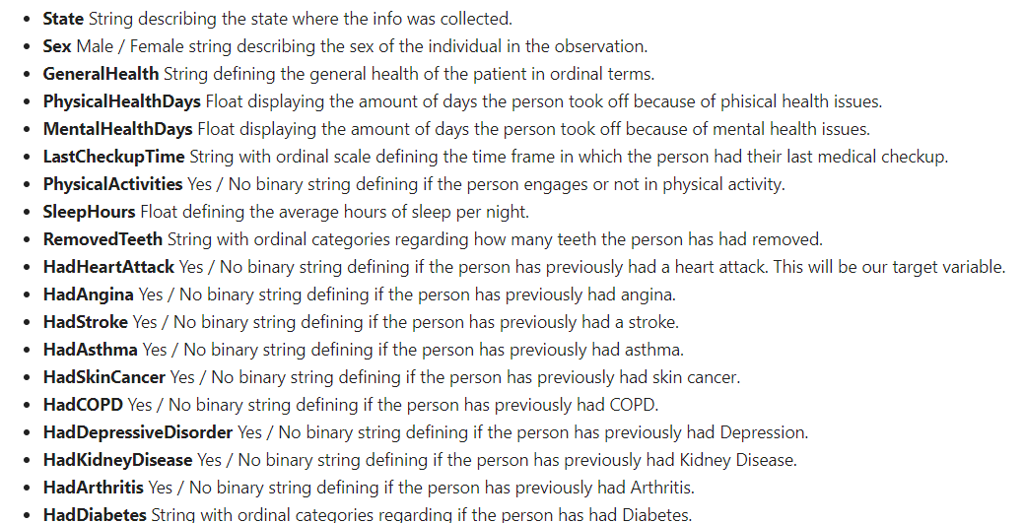
About the Data
Kaggle CDC Dataset 2022
Pre cleaned (removing all null value observations)
246022 observations
40 columns

Slide 4

Project Steps
Data Cleaning and EDA
Model Building (3)
Model Evaluation

Slide 5
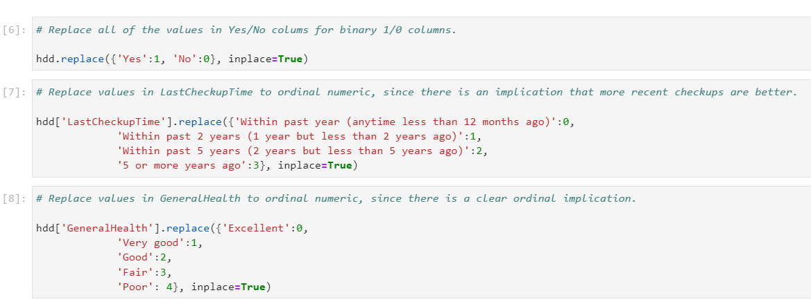
Step 1 Data Cleaning and EDA
Modifying binary string columns to 1,0.
Modifying ordinal string columns with ordered numbers.
Removing non relevant columns.

Slide 6
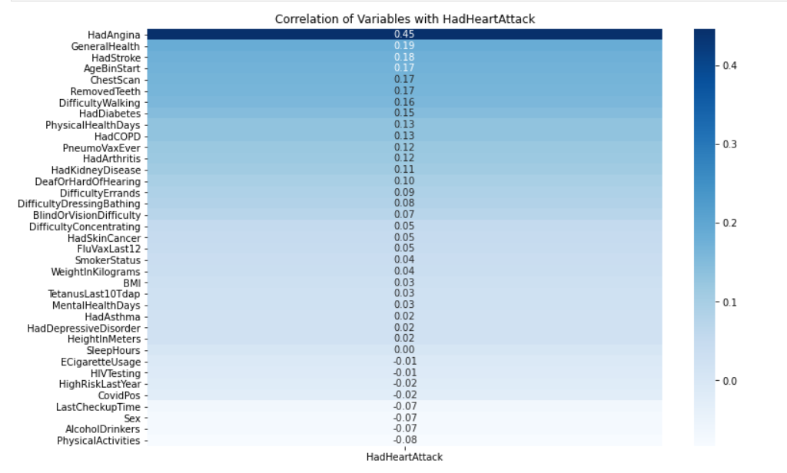
EDA

Slide 7
Model Building
Logistic Regression Model
Support Vector Machine
Decision Tree Classifier

Slide 8

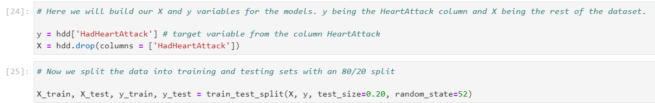
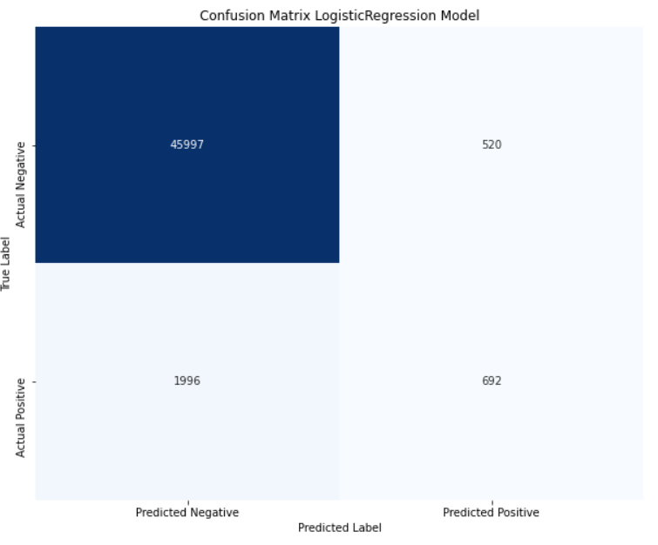
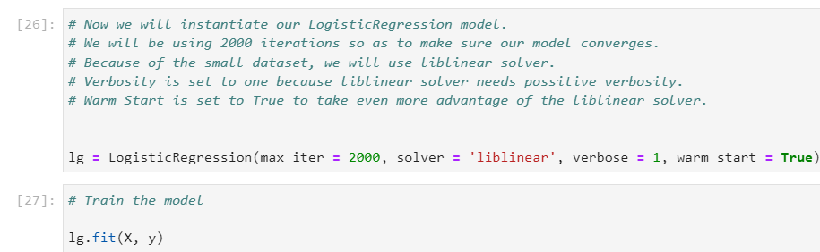
Logistic Regression Model

Slide 9
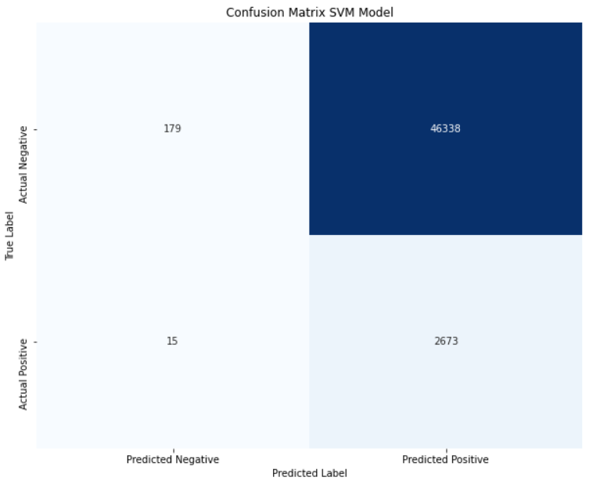
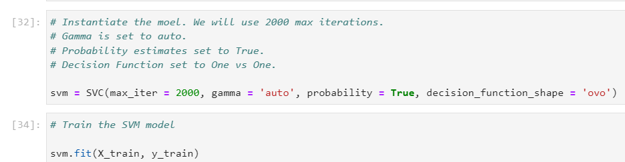
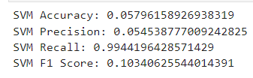
Support vector machine Model

Slide 10
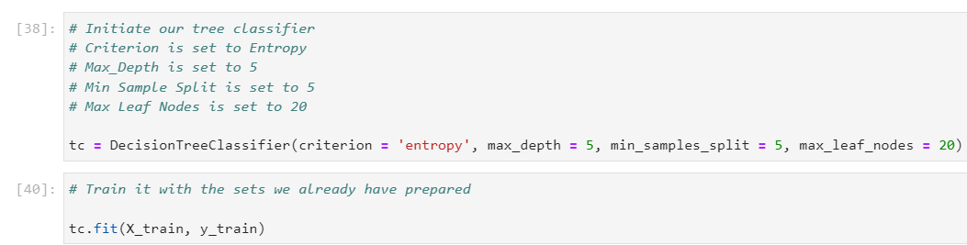

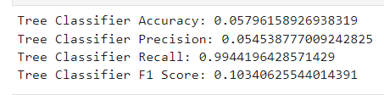
DECISION TREE CLASSIFIER Model

Slide 11
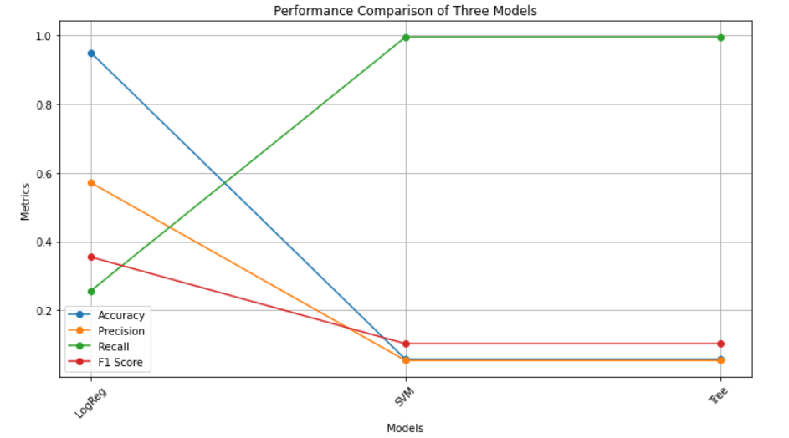
Step 3 Evaluation

Slide 12
Conclusions and suggestions
Health data is incredibly relevant
Be weary of Accuracy
The importance of Basic linear models
The importance of Big Data
Testing other models
Working with larger databases
Focus on Recall
Ensamble models

Slide 13

Thank You

